Slide 1
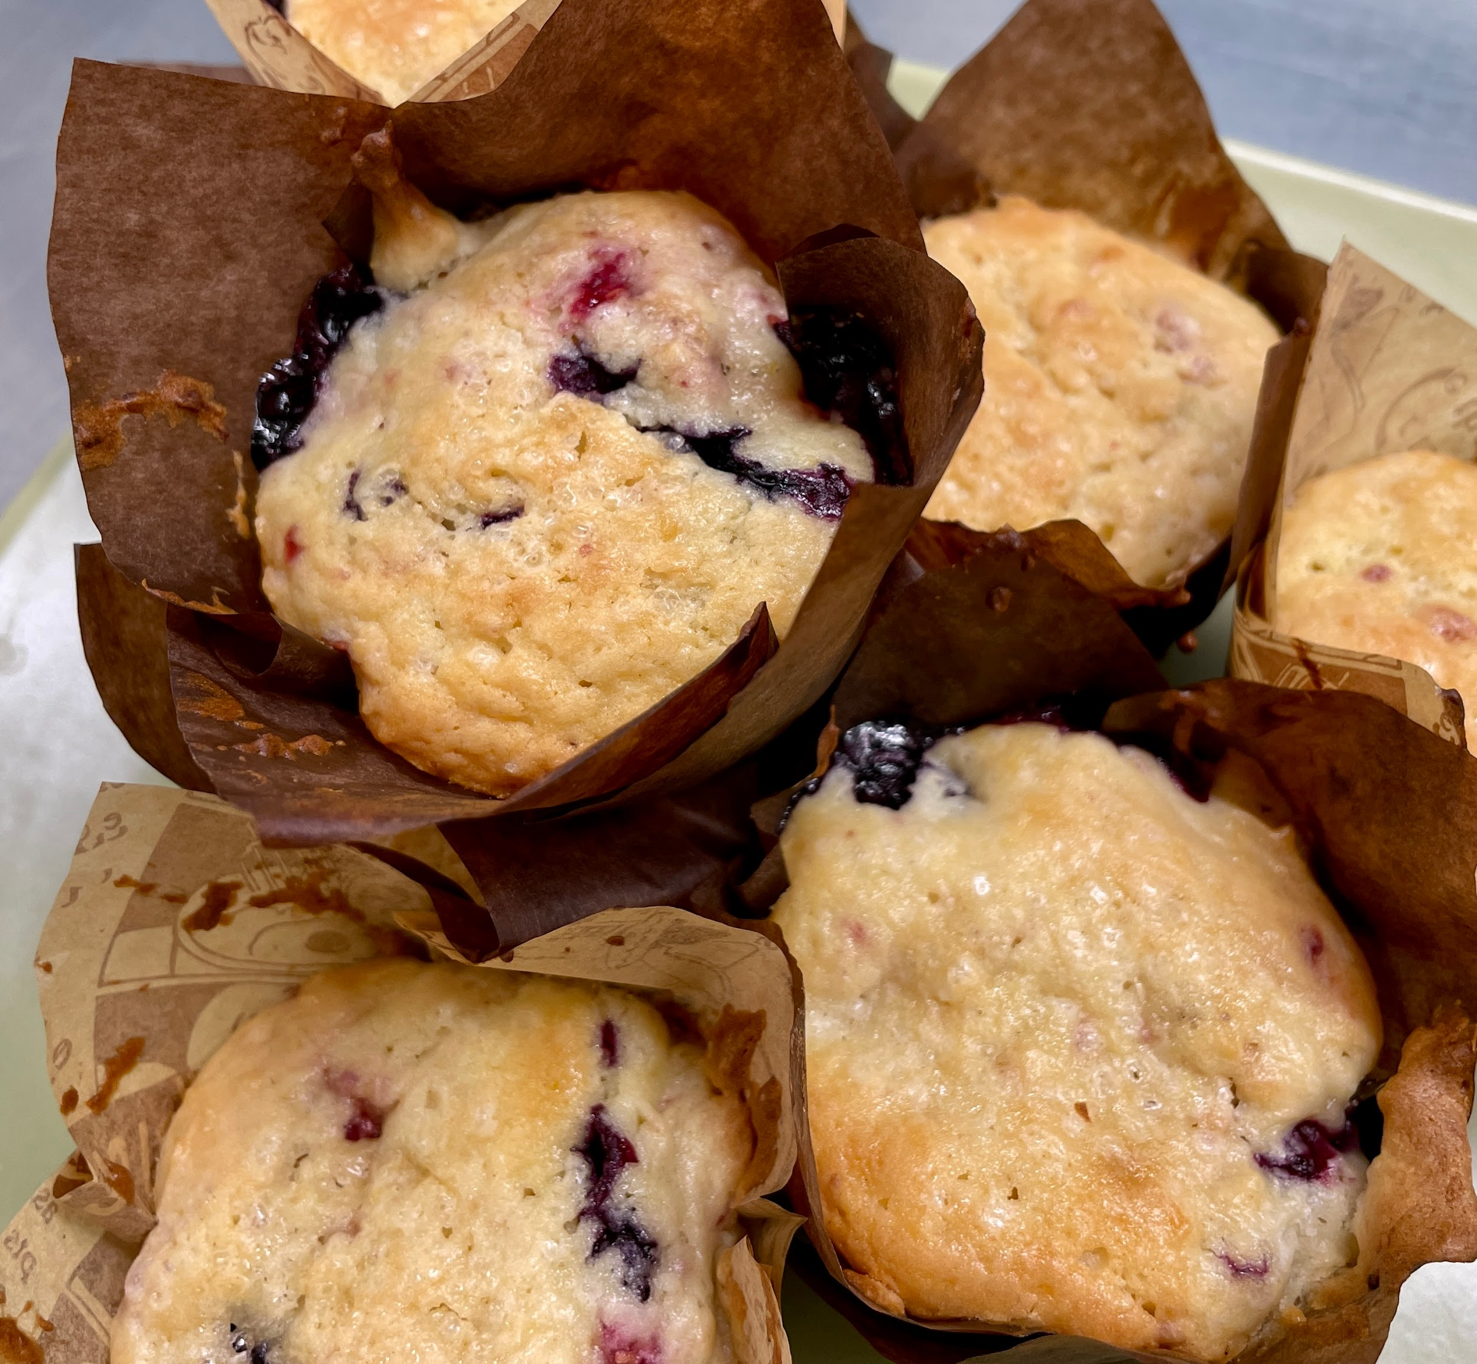
Lemon Berry Muffins
Makes 6 large bakery-style muffins (or 12 standard sized muffins)
Steps
1. Preheat oven to 375°F. Line a standard muffin pan/tin with paper liners (or spray well with non-stick spray).
2. In the bowl of an electric mixer, cream together eggs, butter and sugar until light, white and fluffy (about 5 minutes). Scrape down the sides of the bowl. Add the vanilla, lemon zest and juice and yogurt and beat again until well combined.
3. In a medium-size bowl whisk together 2 cups flour, salt, and baking powder.
4. Gradually mix the dry ingredients into the wet ingredients being careful not to overmix.
5. Toss the berries in the remaining
¼ cup flour and fold them into the batter by hand.
6. Scoop the batter into the muffin tin with a large cookie or ice cream scoop. Sprinkle tops with sanding sugar. Bake for 25 - 30 minutes or until the tops are golden brown and a toothpick comes out clean when inserted in the center.
7. Let muffins cool for 10 minutes before removing them from the pan. These are best eaten the day of but will keep for a few days stored in an airtight container.
Ingredients
2 eggs
½ cup (1 stick) unsalted butter, softened
1 cup granulated sugar
1 tablespoon pure vanilla extract
1 lemon, zested and juiced
½ cup sour cream or plain Greek yogurt
2 ¼ cups all-purpose flour, divided
1 tablespoon baking powder
½ teaspoon kosher salt
½ cup fresh strawberries, diced
½ cup fresh blueberries
1 cup fresh raspberries, halved
2 tablespoons sanding sugar or sugar-in-the-raw to top muffins

